Slide 1
OMR for Mensural Notation: Looking at a Guatemalan Music Manuscript
Martha E. Thomae
SIMSSA Workshop XIX
CIRMMT, McGill University
Montreal, September 21st, 2019
Notes:
During this Summer, I participated in a research exchange at the University of Alicante (Spain), where I worked on different aspects to move forward on my dissertation research. So, before talking about the details of this research exchange, I am going to give a general overview of my dissertation research.

Slide 2
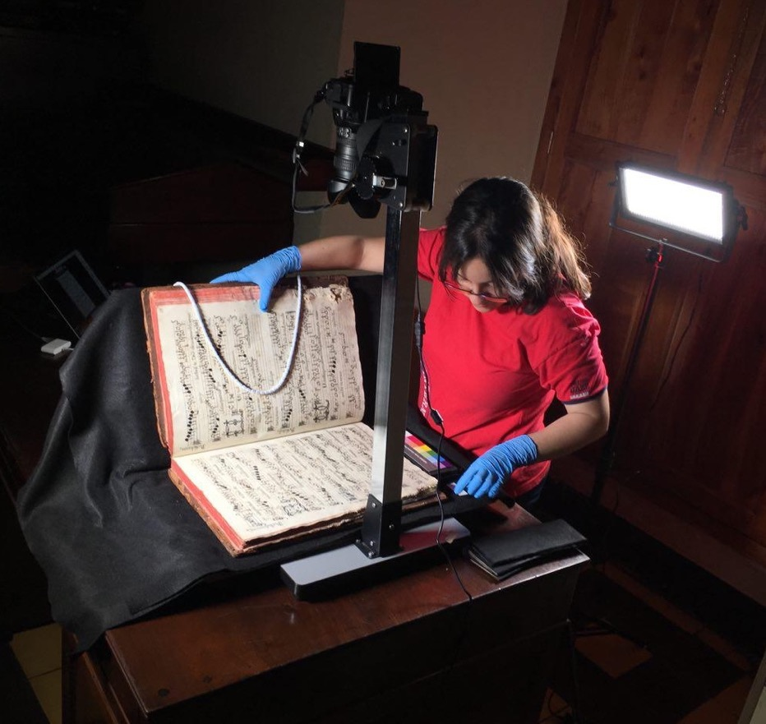
Dissertation Project
Preservation of the colonial musical heritage of Guatemala
Collection of 6 choirbooks written in mensural notation
Increase access to these sources through:
Digitization
OMR
Automatic transcription (into modern values)
GuatC 1: Guatemalan Choirbook 1
January 2019: Digitization stage
Summer 2019: Working on the other two stages
Notes:
My dissertation is about the Preservation of the colonial musical heritage of my home country, Guatemala
[Note 2] Mensural notation was used from the mid-13th century throughout the 16th century (until the 17th century) in Europe
AND it was brought to Guatemala in the 17th century through Spain

Slide 3
Optical Music Recognition (OMR)
Test an End-to-End OMR Approach
(Jorge Calvo-Zaragoza and David Rizo)
Notes:
@ the University of Alicante
Efficient, combines many of the steps of a traditional OMR workflow into a single step

Slide 4
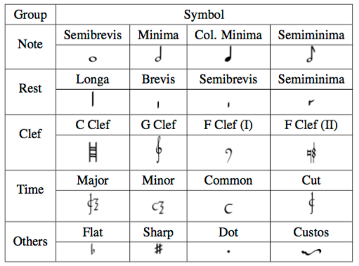
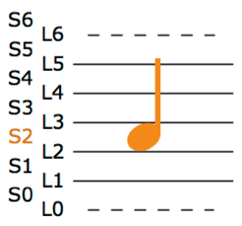
End-to-End OMR Approach
Convolutional Recurrent Neural Network (CRNN) model
Staff level
Extracts two pieces of information for each symbol:
Category of the symbol
Category of its vertical position within the staff
(Pacha and Calvo-Zaragoza, 2018)
(Pacha and Calvo-Zaragoza, 2018)
Notes:
It works at staff-level
And for each symbol of the staff it extracts two pieces of information AT ONCE.
So you have extracted enough information for interpreting rhythm and pitch

Slide 5
End-to-End OMR Approach
Reasons:
Efficiency
Model already trained on Spanish mensural notation
Seventeenth-century manuscript
Corresponding to a complete mass (a 12)
From the Cathedral of Zaragoza
Notes:
Besides efficiency, ...
-> Given the relation between Spain and Guatemala

Slide 6
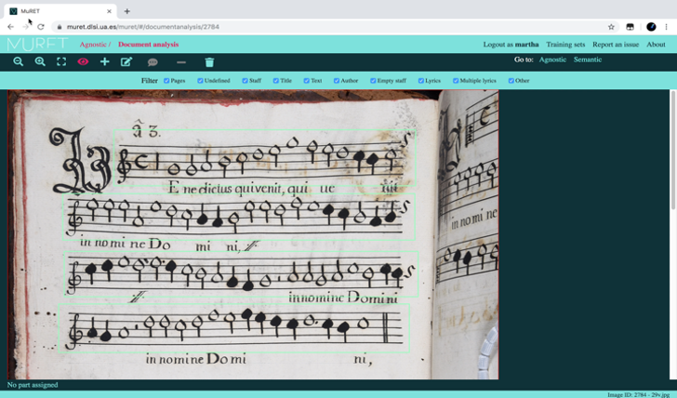
MuRET (Music Recognition, Encoding, and Transcription)

Slide 7
Automatic Transcription of Mensural Notation
Translation Problem:
Graphical encoding (OMR) → Musical meaning

Slide 8
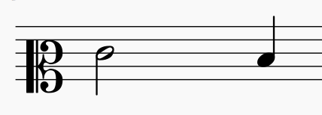
Translator: Agnostic to Semantic
Agnostic Sequence
token = symbol + line/space
Semantic Sequence
token = symbol + pitch
clef.C-L2 note.half-L3 note.quarter-S2
clef.C2 note-E4_half note-D4_quarter
Notes:
*[blue] Output of the OMR system
This provides you, again, enough information regarding rhythm and pitch
Still need more details for mensural notation

Slide 9
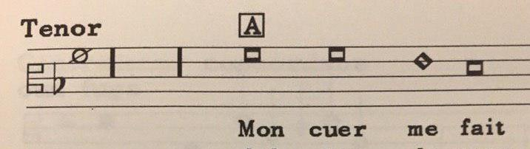
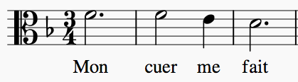
Translator: Agnostic to Semantic
Note shape (i.e., symbol class) is not enough to convey the duration of a note in mensural notation
Notes:
You can see that HERE. You have these two breves, and each of them have different durations.
So, let me explain you what is happening in this example.
What you see here is called a mensuration sign
which basically works as a time signature.
This mensuration sign indicates that this excerpt is written in triple meter.
The issue with mensural notation is that in triple meter the duration of the notes is context-dependent.
The value of these breves is ternary by default
but that ternary value can be turned into binary by the context (i.e., the preceding or following notes, in this case the following) in order to keep the structure of the music in triple meter
Extra info needed in the semantic encoding (besides the symbol) to be comprehensive in your encoding of the rhythmic information

Slide 10
Translation: Agnostic to Semantic
Machine learning based model (sequence-to-sequence model)
Training set: pairs of agnostic and semantic sequences
Not enough training data for mensural notation (yet)
Test the implemented translator:
PrIMuS (Printed Images of Music Staves) dataset
Set of 87,678 real-music incipits
In common Western music notation
https://grfia.dlsi.ua.es/primus/
(Calvo-Zaragoza and Rizo 2018)
Notes:
We wanted to implement a machine-learning model that goes from this agnostic representation (retrieved by the OMR process) into a semantic one
For this, we would need pairs of agnostic & semantic sequences for our training set
Not enough data
Test the implemented translator with another dataset: Primus (modern incipits)
More than 80,000 incipits
In CWMN
That already has these pairs of agnostic & semantic sequences
To see if the model was actually extracting musical meaning from the agnostic sequences

Slide 11
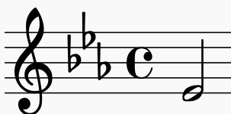
Translator: Agnostic to Semantic
Agnostic Sequence
token = symbol + line/space
Semantic Sequence
token = symbol + pitch
clef.G-L2 accidental.flat-L3 accidental.flat-S4 accidental.flat-S2 metersign.C/-L3 note.half-L1
clef-G2 keySignature-EbM timeSignature-C/ note-Eb4_half
Notes:
[Results]
It does: the model is extracting the musical meaning from these agnostic sequences
Examples
of real sequences
I cropped (after a few symbols)

Slide 12
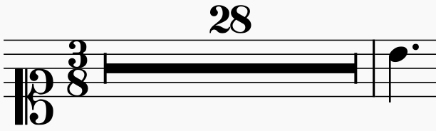
Translator: Agnostic to Semantic
Agnostic Sequence
token = symbol + line/space
Semantic Sequence
token = symbol + pitch
clef.C-L1 digit.3-L4 digit.8-L2 digit.2-S5 digit.8-S5 multirest-L3 barline-L1 note.quarter-S4 dot-S4
clef-C1 timeSignature-3/8 multirest-28 barline note-C5_quarter.

Slide 13
Future Work
Finish performing OMR on the whole GuatC1 manuscript
Obtain the training data for testing the translation model on mensural notation
Compare the machine learning based approach against a heuristic one (MA thesis)

Slide 14



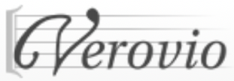



Thank you! martha.thomaeelias@mail.mcgill.ca Special thanks to: José Manuel Iñesta, David Rizo, and Jorge Calvo-Zaragoza
Notes:
CIRMMT Inter-Centre Research Exchange Funding
& Graduate Mobility Award [ Graduate and Postdoctoral Studies (GPS) ]

Slide 15

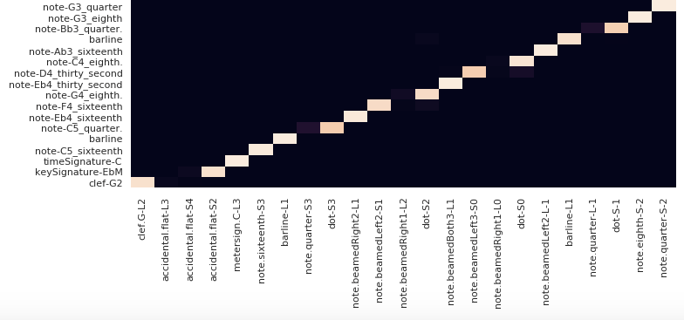
Sequence-to-Sequence Model with Attention

